Slide 1
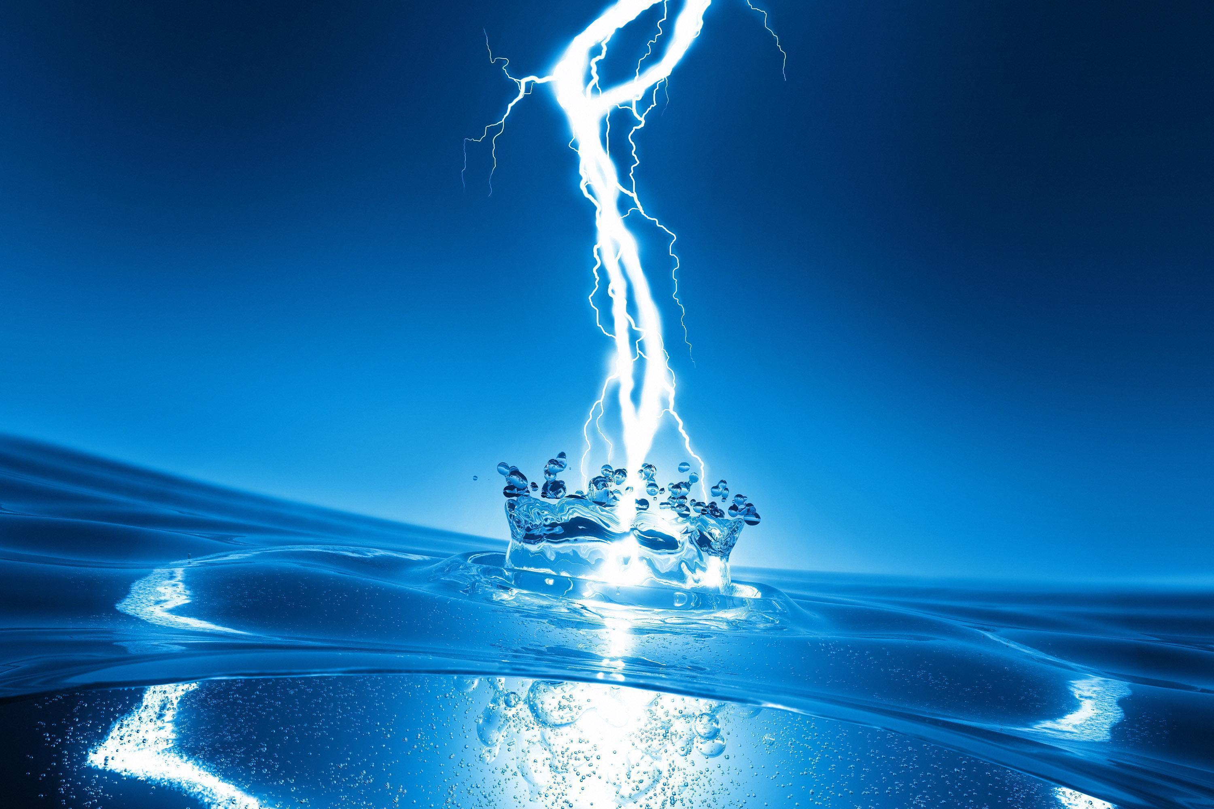
Who Discovered Electricity
By Maison

Slide 2
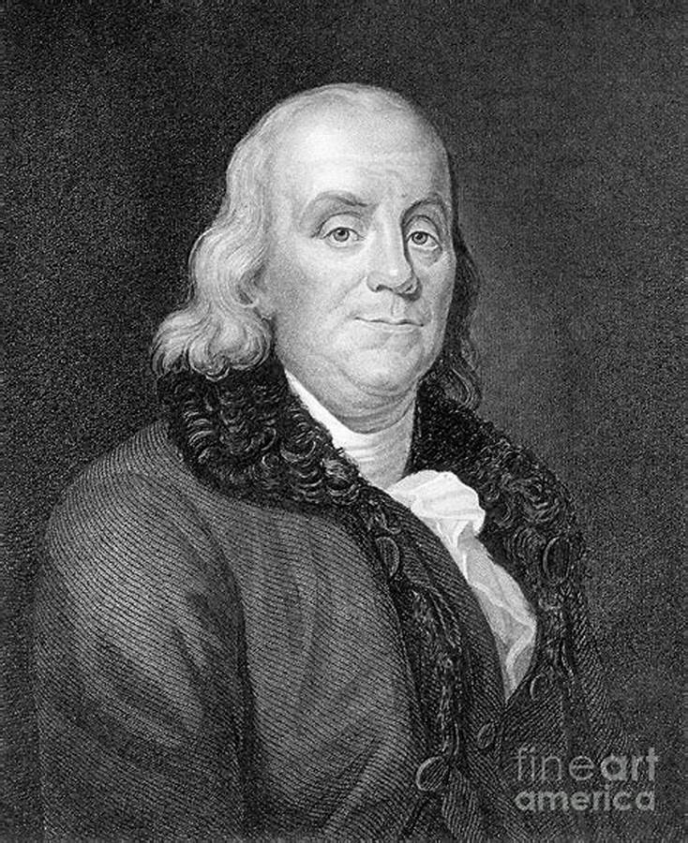
Benjamin Franklin
Since electricity is a natural force that exists in our world, it didn't have to be invented. It did, however, have to be discovered and understood. Most people give credit to Benjamin Franklin for discovering electricity
Although other scientists contributed in his discovery his mainly discovered it

Slide 3
When was he born and when did he die
Benjamin Franklin

